Slide 1
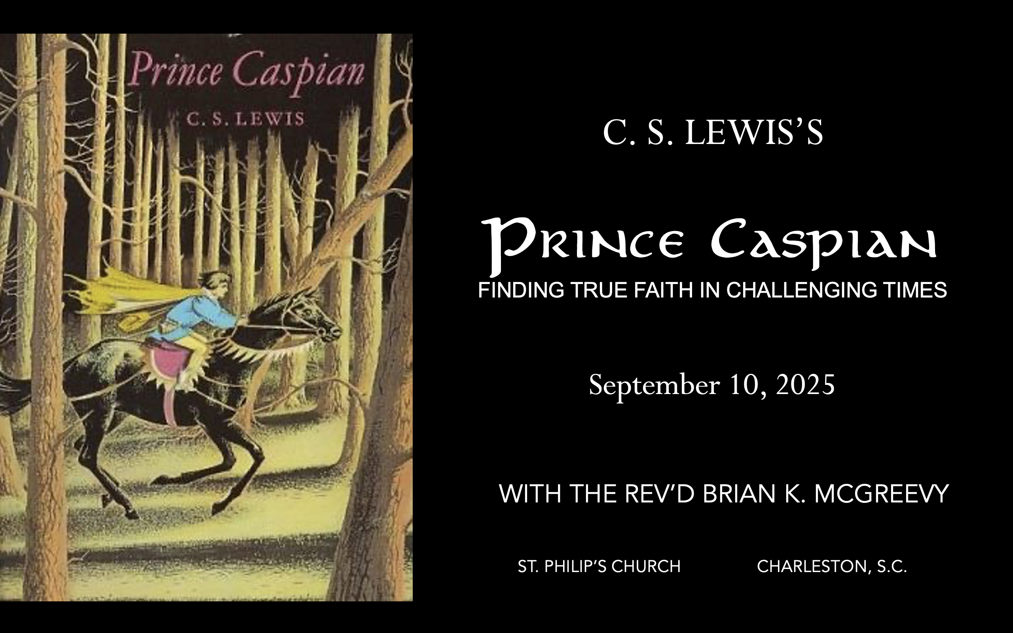

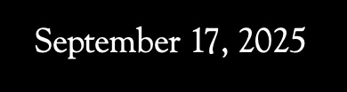
November 19, 2025
September 24, 2025
February 4, 2026
October 1, 2025
December 3, 2025
November 5, 2025
October 8, 2025
October 15, 2025
October 29, 2025
October 22, 2025

Slide 2
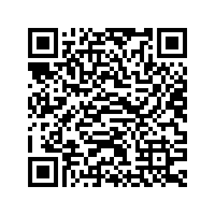
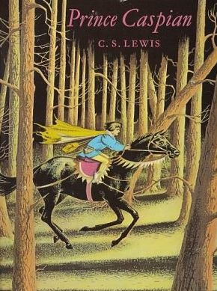
How to approach this class:
How to approach this class:
--On the beach
--Snorkeling
--Scuba diving
--Email list/QR code
How to read this book:
--Try reading aloud and slowly, looking for layers of meaning
--Look for themes/underline and highlight passages that resonate with you
What we’ll be doing:
--Setting the background and context
--Following the story chapter by chapter
--Drawing out principles for living with Joy and Purpose
--Looking at relevant Scripture

Slide 3
For you were once darkness, but now you are light in the Lord. Live as children of light (for the fruit of the light consists in all goodness, righteousness, and truth), and find out what pleases the Lord.
Have nothing to do with the fruitless deeds of darkness, but rather expose them. It is shameful even to mention what the disobedient do in secret. But everything exposed by the light becomes visible—and everything that is illuminated becomes a light. This is why it is said: “Wake up, sleeper, rise from the dead, and Christ will shine on you.” Be very careful, then, how you live— not as unwise but as wise, making the most of every opportunity because the days are evil.
Ephesians 5:8-15

Slide 4
Why Narnia matters SO much today
Aggressively secular narrative pervading our culture—how to counter?
Which Story Can We Trust? Either
We are here by accident, meaningless products of a random process. We create our own identity and can only invent meaning and purpose in life and do our best to stay alive—even though there is no point to life. Sartre, Dawkins, Nietzsche, most schools
OR
We are precious creatures made by and in the image of a loving God, who has created us for something special that we are asked to do. We have the privilege of being able to do good and experience purpose as we live by faith in Christ in His Kingdom. The witness of Scripture, the Church, and the saints
These two stories are totally incompatible. They can’t both be right: cognitive dissonance. So which do we trust? Other stories, like the Chronicles of Narnia, can help us here by highlighting dissonance or by creating a narrative we want to inhabit. So which do we trust? Is Jadis really the Queen of the realm of Narnia? OR Is she the White Witch, a usurper in Narnia, which is really the realm of the mysterious great and noble lion, Aslan?
Gradually, one story about Narnia emerges as supremely plausible, as each individual story turns out to be part of this greater narrative. This grand narrative of interlocking stories makes sense of the riddles the children see and experience and reveals the character of each narrative. These stories teach that Biblical truth and the wisdom of the world cannot both be True---we need to learn to think critically because we are surrounded by falsehood.
We each have our unique story. But our own story needs to be brought into connection with a grand narrative, a big story which gives our story a new importance and significance. Why? Because we realize that our story is framed by something greater which gives us value and purpose. Lewis’s remarkable achievement in Narnia is to allow his readers to inhabit this big story, to get inside it and feel what it is like to be part of it. --Rev. Dr. Alister McGrath, Holder of the Andreas Idreos Chair in Science and Religion, Oxford University (Ph.D. in Molecular Biophysics, Doctor of Divinity in Theology, and Ph.D. in Intellectual History, at Oxford)

Slide 5
“The shaping of our loves, desires, and imagination thus happens primarily
The Narnia stories are deeply grounded in the Biblical story and its four major scenes of Creation, Fall, Redemption, and New Creation. The White Witch, Miraz, and other evil characters in the Narnia stories are all engaged in the evil enchantment of encouraging a
Disciplined Forgetting of Aslan, his Story, and the Deep Magic.

Slide 6
Why Prince Caspian is especially relevant today
Imagine living in a land
--that had forgotten its history and substituted a revisionist narrative that said all evidences of the Divine were foolish myths,
--where individuals struggled to practice their faith while being surrounded by a sea of doubters and skeptics,
--where Evil seemed poised to triumph over Good, and
-- where even the strongest believers wondered sometimes whether they had been abandoned.
Welcome to the world of Prince Caspian, the next book of the Chronicles of Narnia after The Lion, the Witch, and the Wardrobe. C.S. Lewis wrote that this book concerns the “restoration of the true religion after a corruption.
We will be examining such themes as
--how disbelief and doubt creep into our lives,
--the effects of living under the wrong framework of reality,
--the importance of cultivating virtue and courage, and
--the priority of seeking the Kingdom of God with our whole heart.

Slide 7
Chapter 11: “The Lion Roars”
Lucy tells the others that she must follow Aslan, even if it means going alone, which meets with major objections from the others, especially Susan, but eventually they agree and follow Lucy.
None of the others can see Aslan, but Lucy keeps her eyes fixed on him and leads them through the woods to a secret way down.
First Edmund and then Peter are able to see Aslan as they emerge from the difficult trek and arrive at Aslan’s How, and then Susan and Trumpkin see him as well.
Aslan shows mercy to Peter and Susan for their lack of faith, draws in Trumpkin the unbeliever, and then wakes the Trees, and a romp ensues.
THEMES
Following Aslan/Christ may demand courage and persevering in the face of opposition even from those closest to you.
Keeping your eyes fixed on Aslan/Christ is the way to remain at peace even in the midst of dire and dangerous circumstances.
Trusting Aslan’s guidance rather than your own understanding is the way of wisdom.
Listening to fears can have dreadful consequences and cause hurt to yourself and others.
The presence of Aslan creates Joy and leads to celebration.

Slide 8
Chapter 12: “Sorcery and Sudden Vengeance”
As Peter, Edmund, and Trumpkin arrive at Aslan’s How, they hear raised voices coming from an inner chamber and figure out that a council is taking place with King Caspian, Nikabrik the Dwarf, Trufflehunter the Badger, Dr. Cornelius, and two others.
While Trufflehunter counsels waiting on Aslan and seeing what help may come, Nikabrik says there is no such help coming and that they can wait no longer and suggests his unnamed friends, an old woman and a bloodthirsty soldier, can help.
Given that no help has come, Nikabrik says it is foolhardy to rely on myths and his plan is to call on other ancient powers, namely the White Witch, and that he doesn’t believe any stories about Aslan or
his coming to life again, and that the Witch would be a better ally.
Nikabrik and his friends, who are revealed to be a Hag and a Werewolf, determine to summon up. The White Witch, and a fight breaks out, which ends when Edmund and Peter and Trumpkin burst in to
save King Caspian.
THEMES
Waiting and patience may be part of Aslan’s/God’s plan of deliverance.
Taking matters into your own hands when Aslan/God does not act on your timetable is dangerous.
Doubts about Aslan/Christ and his coming to life again lead to dismissing who he is.
Believing the wrong metanarrative can cause you to call Evil Good.
Faithfulness will be rewarded.

Slide 9
While Trufflehunter counsels waiting on Aslan and seeing what help may come, Nikabrik says there is no such help coming and that they can wait no longer and suggests his unnamed friends, an old woman and a bloodthirsty soldier, can help.
“To speak plainly," said Nikabrik, "your wallet's empty, your eggs addled, your fish uncaught, your promises broken. Stand aside then and let others work. And that is why —" "The help will come," said Trufflehunter. "I stand by Aslan. Have patience, like us beasts. The help will come. It may be even now at the door." "Pah!" snarled Nikabrik. "You badgers would have us wait till the sky falls and we can all catch larks. I tell you we can't wait. Food is running short; we lose more than we can afford at every encounter; 88 Clive Staples Lewis our followers are slipping away.” "Oh, stop it, both of you," said King Caspian. "I want to know what it is that Nikabrik keeps on hinting we should do. But before that, I want to know who those two strangers are whom he has brought into our council and who stand there with their ears open and their mouths shut." "They are friends of mine," said Nikabrik.
Given that no help has come, Nikabrik says it is foolhardy to rely on myths and his plan is to call on other ancient powers, namely the White Witch, and that he doesn’t believe any stories about Aslan
or his coming to life again, and that the Witch would be a better ally.
"All said and done," he muttered, "none of us knows the truth about the ancient days in Narnia. Trump- kin believed none of the stories. I was ready to put them to the trial. We tried first the Horn and it has failed. If there ever was a High King Peter and a Queen Susan and a King Edmund and a Queen Lucy, then either they have not heard us, or they cannot come, or they are our enemies —"But when your sword breaks, you draw your dagger. The stories tell of other powers beside the ancient Kings and Queens. How if we could call them up?""Who do you mean?" said Caspian at last. "I mean a power so much greater than Aslan's that it held Narnia spellbound for years and years, if the stories are true." "The White Witch!" cried three voices all at once…”

Slide 10
Nikabrik and his friends, who are revealed to be a Hag and a Werewolf, determine to summon up the White Witch, and a fight breaks out, which ends when Edmund and Peter and Trumpkin burst in to
save King Caspian.
"Call her up," said the grey voice. "We are all ready. Draw the circle. Prepare the blue fire." Above the steadily increasing growl of the Badger and Cornelius's sharp "What?" rose the voice of King Caspian like thunder. "So that is your plan, Nikabrik! Black sorcery and the calling up of an accursed ghost. And I see who your companions are-a Hag and a Werewolf!" The next minute or so was very confused. There was an animal roaring, a clash of steel; the boys and Trumpkin rushed in; Peter had a glimpse of a horrible, grey, gaunt creature, half man and half wolf, in the very act of leaping upon a boy about his own age, and Edmund saw a badger and a Dwarf rolling on the floor in a sort of cat fight…"Is King Caspian anywhere?" asked Peter. "I'm here," said a rather faint voice. "Something bit me." They all heard the noise of some- one striking a match. It was Edmund. The little flame showed his face, looking pale and dirty. He blundered about for a little, found the candle (they were no longer using the lamp, for they had run out of oil), set it on the table, and lit it. When the flame rose clear, several people scrambled to their feet.
Six faces blinked at one another in the candlelight. "We don't seem to have any enemies left," said Peter. "There's the Hag, dead." (He turned his eyes quickly away from her.) "And Nikabrik, dead too. And I suppose this thing is a Werewolf. It's so long since I've seen one. Wolf's head and man's body. That means he was just turning from man into wolf at the moment he was killed. And you, I suppose, are King Caspian?" "Yes," said the other boy. "But I've no idea who you are." "It's the High King, King Peter," said Trumpkin. "Your Majesty is very welcome," said Caspian. "And so is your Majesty," said Peter. "I haven't come to take your place, you know, but to put you into it."
THEMES
Waiting and patience may be part of Aslan’s/God’s plan of deliverance.
Taking matters into your own hands when Aslan/God does not act on your timetable is dangerous.
Doubts about Aslan/Christ and his coming to life again lead to dismissing who he is.
Believing the wrong metanarrative can cause you to call Evil Good.
Faithfulness will be rewarded.

Slide 11
THEMES
Waiting and patience may be part of Aslan’s/God’s plan of deliverance.
“Tell that tale your own way for all I care," answered Nikabrik. "But whether it was that the Horn was blown too late, or whether there was no magic in it, no help has come. You, you great clerk, you master magician, you know-all; are you still asking us to hang our hopes on Aslan and King Peter and all the rest of it?" "I must confess — I cannot deny it — that I am deeply disappointed in the result of the operation," came the answer. ("That'll be Doctor Cornelius," said Trumpkin.) "The help will come," said Trufflehunter. "I stand by Aslan. Have patience, like us beasts. The help will come. It may be even now
at the door." "Pah!" snarled Nikabrik. "You badgers would have us wait till the sky falls and we can all catch larks. I tell you we can't wait. Food is running short; we lose more than we can afford at every encounter--our followers are slipping away."
But they who wait for the Lord shall renew their strength; they shall mount up with wings like eagles; they shall run and not be weary; they shall walk and not faint. Is. 40:31 I believe that I shall look upon the goodness of the Lord in the land of the living! Wait for the Lord; be strong, and let your heart take courage; wait for the Lord! Ps. 27:13-14 Be patient, therefore, brothers, until the coming of the Lord. See how the farmer waits for the precious fruit of the earth, being patient about it, until it receives the early and the late rains. You also, be patient. Establish your hearts, for the coming of the Lord is at hand. James 5:7-8 Be still before the Lord and wait patiently for him; fret not yourself over the one who prospers in his way, over the man who carries out evil devices! Ps. 37:7
Taking matters into your own hands when Aslan/God does not act on your timetable is dangerous.
“I want to know what it is that Nikabrik keeps on hinting we should do. But before that, I want to know who those two strangers are whom he has brought into our council and who stand there with their ears open and their mouths shut." "They are friends of mine," said Nikabrik. "Why am I to be the only one who can't bring in his friends?" "His Majesty is the King to whom you have sworn allegiance," said Trufflehunter sternly. "Court manners, court manners," sneered Nikabrik. "But in this hole we may talk plainly. You know — and he knows that this Telmarine boy will be king of nowhere and nobody in a week unless we can help him out of the trap in which he sits."A dull, grey voice at which Peter's flesh crept replied, "I'm hunger. I'm thirst. Where I bite, I hold till I die, and even after death they must cut out my mouthful from my enemy's body and bury it with me. I can fast a hundred years and not die. I can lie a hundred nights on the ice and not freeze. I can drink a river of blood and not burst. Show me your enemies."

Slide 12
Taking matters into your own hands when Aslan/God does not act on your timetable is dangerous.
“I want to know what it is that Nikabrik keeps on hinting we should do. But before that, I want to know who those two strangers are whom he has brought into our council and who stand there with their ears open and their mouths shut." "They are friends of mine," said Nikabrik. "Why am I to be the only one who can't bring in his friends?" "His Majesty is the King to whom you have sworn allegiance," said Trufflehunter sternly. "Court manners, court manners," sneered Nikabrik. "But in this hole we may talk plainly. You know — and he knows that this Telmarine boy will be king of nowhere and nobody in a week unless we can help him out of the trap in which he sits."A dull, grey voice at which Peter's flesh crept replied, "I'm hunger. I'm thirst. Where I bite, I hold till I die, and even after death they must cut out my mouthful from my enemy's body and bury it with me. I can fast a hundred years and not die. I can lie 100 nights on the ice and not freeze. I can drink a river of blood and not burst. Show me your enemies.”
Now Sarai, Abram's wife, had borne him no children. She had a female Egyptian servant whose name was Hagar. And Sarai said to Abram, “Behold now, the Lord has prevented me from bearing children. Go in to my servant; it may be that I shall obtain children by her.” And Abram listened to the voice of Sarai. So, after Abram had lived ten years in the land of Canaan, Sarai, Abram's wife, took Hagar the Egyptian, her servant, and gave her to Abram her husband as a wife. And he went in to Hagar, and she conceived. And when she saw that she had conceived, she looked with contempt on her mistress. And Sarai said to Abram, “May the wrong done to me be on you! I gave my servant to your embrace, and when she saw that she had conceived, she looked on me with contempt. May the Lord judge between you and me!” Gen. 16 And Samuel said to Saul, “You have done foolishly. You have not kept the command of the Lord your God, with which he commanded you. For then the Lord would have established your kingdom over Israel forever. But now your kingdom shall not continue. The Lord has sought out a man after his own heart, and the Lord has commanded him to be prince^{[b]} over his people, because you have not kept what the Lord commanded you.” I Sam. 13:13-14

Slide 13
Doubts about Aslan/Christ and his coming to life again lead to dismissing who he is.
“Aslan and the Kings go together. Either Aslan is dead, or he is not on our side. Or else something stronger than himself keeps him back. And if he did come — how do we know he'd be our friend? He was not always a good friend to Dwarfs by all that's told. Not even to all beasts. Ask the Wolves. And anyway, he was in Narnia only once that I ever heard of, and he didn't stay long. You may drop Aslan out of the reckoning. I was thinking of someone else. As for power, do not the stories say that the Witch defeated Aslan, and bound him, and killed him on that very stone which is over there, just beyond the light?" "But they also say that he came to life again," said the Badger sharply. "Yes, they say," answered Nikabrik, "but you'll notice that we hear precious little about anything he did afterwards. He just fades out of the story. How do you explain that, if he really came to life? Isn't it much more likely that he didn't, and that the stories say nothing more about him because there was nothing more to say?” "He established the Kings and Queens," said Caspian. "A King who has just won a great battle can usually establish himself with- out the help of a performing lion," said Nikabrik.
If there is no resurrection of the dead, then not even Christ has been raised. And if Christ has not been raised, our preaching is useless and so is your faith. More than that, we are then found to be false witnesses about God, for we have testified about God that he raised Christ from the dead. But he did not raise him if in fact the dead are not raised. For if the dead are not raised, then Christ has not been raised either. And if Christ has not been raised, your faith is futile; you are still in your sins. Then those also who have fallen asleep in Christ are lost. If only for this life we have hope in Christ, we are of all people most to be pitied. I Cor. 15:13-19 Remember Jesus Christ, risen from the dead, the offspring of David, as preached in my gospel, for which I am suffering, bound with chains as a criminal. But the word of God is not bound! Therefore I endure everything for the sake of the elect, that they also may obtain the salvation that is in Christ Jesus with eternal glory. I Tim. 2:8-10
Believing the wrong metanarrative can cause you to call Evil Good.
"And anyway," Nikabrik continued, "what came of the Kings and their reign? They faded too. But it’s very different with the Witch. They say she ruled for a hundred years: a hundred years of winter. There's power, if you like. There's something practical." "But, heaven and earth!" said the King, "haven't we always been told that she was the worst enemy of all? Wasn't she a tyrant ten times worse than Miraz?" "Perhaps," said Nikabrik in a cold voice. "Perhaps she was for you humans, if there were any of you in those days. Perhaps she was for some of the beasts. She stamped out the Beavers, I dare say; at least there are none of them in Narnia now. But she got on all right with us Dwarfs. I'm a Dwarf and I stand by my own people. We're not afraid of the Witch."
Faithfulness will be rewarded.

Slide 14
Believing the wrong metanarrative can cause you to call Evil Good.
"And anyway," Nikabrik continued, "what came of the Kings and their reign? They faded too. But it’s very different with the Witch. They say she ruled for a hundred years: a hundred years of winter. There's power, if you like. There's something practical." "But, heaven and earth!" said the King, "haven't we always been told that she was the worst enemy of all? Wasn't she a tyrant ten times worse than Miraz?" "Perhaps," said Nikabrik in a cold voice. "Perhaps she was for you humans, if there were any of you in those days. Perhaps she was for some of the beasts. She stamped out the Beavers, I dare say; at least there are none of them in Narnia now. But she got on all right with us Dwarfs. I'm a Dwarf and I stand by my own people. We're not afraid of the Witch."
Woe to those who call evil good and good evil, who put darkness for light and light for darkness, who put bitter for sweet and sweet for bitter! Woe to those who are wise in their own eyes, and shrewd in their own sight! Is. 5:20-21 He who justifies the wicked and he who condemns the righteous are both alike an abomination to the Lord. Prov. 17:15 Though they know God's righteous decree that those who practice such things deserve to die, they not only do them but give approval to those who practice them. Rom. 1:32 Now the Spirit expressly says that in later times some will depart from the faith by devoting themselves to deceitful spirits and teachings of demons, I Tim. 4:1
Faithfulness will be rewarded.
"Your Majesty," said another voice at Peter's elbow. He turned and found himself face to face with the Badger. Peter leaned forward, put his arms round the beast and kissed the furry head: it wasn't a girlish thing for him to do, because he was the High King. "Best of badgers," he said. "You never doubted us all through." "No credit to me, your Majesty," said Trufflehunter. "1'm a beast and we don't change. I'm a badger, what's more, and we hold on.” Blessed is the man who remains steadfast under trial, for when he has stood the test he will receive the crown of life, which God has promised to those who love him. James 1:12 His master

Slide 15
said to him, ‘Well done, good and faithful servant. You have been faithful over a little; I will set you over much. Enter into the joy of your master.’ Mt. 25:21 And without faith it is impossible to please him, for whoever would draw near to God must believe that he exists and that he rewards those who seek him. Heb. 11:6 Therefore, my beloved brothers, be steadfast, immovable, always abounding in the work of the Lord, knowing that in the Lord your labor is not in vain. I Cor. 15:58

Slide 16
DEEPER DIVE: DISCERNING THE RIGHT METANARRATIVE
“I was taught at school, when I had done a sum, to “prove my answer”. The proof or verification of my Christian answer to the cosmic sum is this. When I accept Theology I may find difficulties, at this point or that, in harmonizing it with some particular truths which are imbedded in the mythical cosmology derived from science. But I can get in, or allow for, science as a whole. Granted that Reason is prior to matter and that the light of the primal Reason illuminates finite minds, I can understand how men should come by observation and inference, to know a lot about the universe they live in. If, on the other hand, I swallow the scientific cosmology as a whole, then not only can I not fit in Christianity, but I cannot even fit in science. If minds are wholly dependent on brains, and brains on bio-chemistry, and bio-chemistry (in the long run) on the meaningless flux of the atoms, I cannot understand how the thought of those minds should have any more significance than the sound of the wind in the trees. And this is to me the final test. This is how I distinguish dreaming and waking.
"The waking world is judged more real because it can contain the dreaming world; the dreaming world is judged less real because it cannot contain the waking one. For the same reason I am certain that in passing from the scientific points of view to the theological, I have passed from dream to waking. Christian theology can fit in science, art, morality, and the sub-Christian religions. The scientific point of view cannot fit in any of

Slide 17
these things, not even science itself. I believe in Christianity as I believe that the Sun has risen, not only because I see it, but because by it I see everything else." ("Is Theology Poetry," in The Weight of Glory)
“Reality, in fact, is usually something you could not have guessed. That is one of the reasons I believe Christianity. It is a religion that you could not have guessed. If it offered us just the kind of universe we had always expected, I should feel we were making it up. But, in fact, it is not the sort of thing anyone would have made up. It has just that queer twist about it that real things have. So let us leave behind all these boys’ philosophies – – these over-simple answers. The problem is not simple and the answer is not going to be simple either.” (C.S. Lewis, Mere Christianity, Book II, chapter 2, “The Invasion,” page 36).
C.S. Lewis made a similar point in The Silver Chair through his character Puddleglum. When Puddleglum is giving his apologetic to the Queen of the Underland he says:
“One word, Ma’am,” he said, coming back from the fire; limping, because of the pain. “One word. All you’ve been saying is quite right, I shouldn’t wonder. I’m a chap who always liked to know the worst and then put the best face I can on it. But there’s one more thing to be said, even so. Suppose we have only dreamed, or made up, all those things – -trees and grass and sun and moon and Aslan himself. Suppose we have. Then all I can say is that, in that case, the made-up seem a good deal more real than the real ones. Suppose this black pit of a kingdom of yours is the only world. Well, it strikes me as a pretty poor one. And that’s a funny

Slide 18
thing when you come to think of it. We’re just babies making up a game if you’re right. But four babies playing a game can make a play-world that licks your real world hollow. That’s why I’m going to stand by the play world. I’m on Aslan’s side even if there isn’t any Aslan to lead it. I’m going to live on like a Narnian as I long as I can even if there isn’t any Narnia.”

